Slide 1
How the Internet and ICT can be more significant than carbon taxes or cap and trade in reducing Global Warming
Bill St. Arnaud
CANARIE Inc – www.canarie.ca
Bill.st.arnaud@canarie.ca
Unless otherwise noted all material in this slide deck may be reproduced, modified or distributed without prior permission of the author

Slide 2
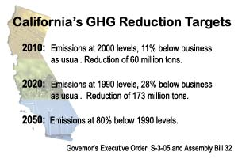
Biggest Challenge facing Planet

Slide 3
Solutions to reduce global warming
Carbon taxes
  Politically difficult to sell
Cap and trade
  Useful for big emitters like power companies
  Addresses only supply side of CO2
Carbon offsets
  Immature market with no standards
  But addresses demand side of CO2 by businesses and consumers
Carbon Neutrality imposed by law
  Growing in popularity especially as protests over gas tax escalates
But there may be another approach….

Slide 4
Carbon Rewards rather than Carbon Taxes
Rather than penalize consumers and businesses for carbon emissions, can we reward them for reducing their carbon emissions?
Using Internet and ICT to provide “virtual” products and services directly as a replacement for real equivalents, but also as incentive to “reward” consumers to reduce their own carbon footprint in other activities
  Virtual networks and computers for business
  Cloud computing, Web 2.0 applications
  Next generation solar powered PDAs and cell phones for access to the Internet
  eMusic, eFilm, eBooks for consumer
Bits and bandwidth are virtually carbon free
  especially if we use zero carbon data centers and optical networks

Slide 5
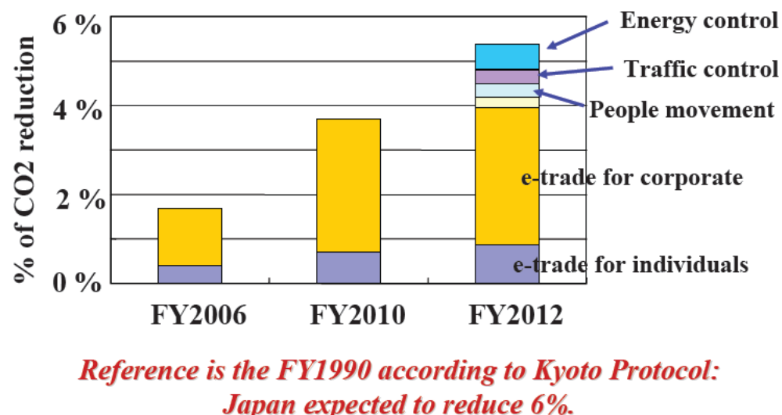
ICT and Virtualization may allow us to achieve Kyoto targets
In 2012 application of ICTs to other sectors will contribute to reduction of 68 million tons of CO2, which is equivalent to 5.4% of CO2 emission in 1990in Japan.
90% of Kyoto commitments by Japan
Dr Yuji INOUE's presentation http://www.itu.int/dms_pub/itu-t/oth/06/0F/T060F0060080025PDFE.pdf

Slide 6
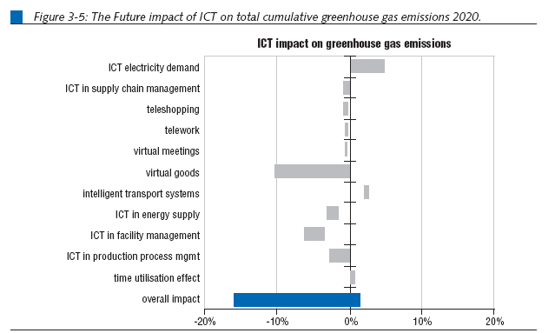
Step 3: Virtualization and De-materialization
Direct replacement of physical goods – 10% impact
Source: European Commission Joint Research Centre, “The Future Impact of ICTs on Environmental Sustainability”, August 2004

Slide 7
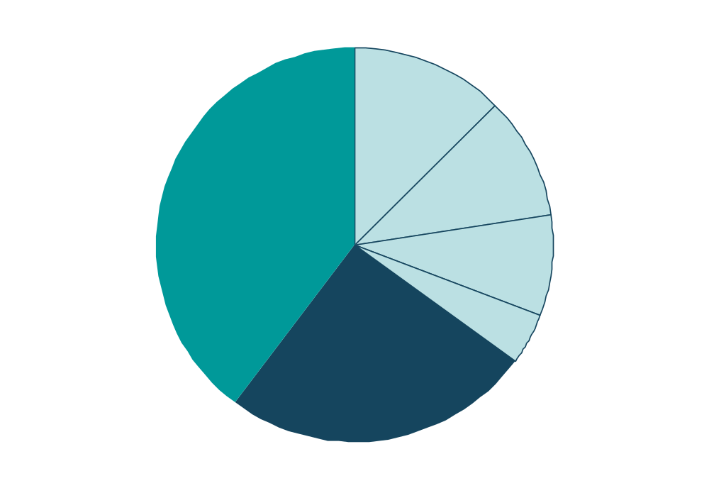
Consumers control or influence 60 per cent of emissions
Emissions under direct consumer control (35%)
Other sectors (40%)
(e.g. manufacturing, coal mining, export transport)
Heating
Private cars
Electricity
Other transport
Consumer influenced sectors (25%)
(e.g. retail, food and drink, wholesale, agriculture, public sector)
http://www.cbi.org.uk/pdf/climatereport2007full.pdf

Slide 8
Four steps of reducing CO2 through ICT
Clean up our own act – the ICT industry itself must be zero carbon
  Build zero carbon data centers connected by optical networks
  Deploy grids, clouds and virtual computers at these facilities
Eliminate enterprise servers and move existing business and consumer applications to clouds and virtual servers at zero carbon data centers
Eliminate consumer PC and use hand held devices or solar powered devices to access applications over Internet
  RIM Blackberry or Apple iPhone
Initiate programs to offer virtual products over zero carbon Internet to consumers & business as a reward for reducing their carbon footprint
2%
2%
1%
10%?
Total CO2 reduction by 2020: 5-15%
Total Required by 2020: 15-30%

Slide 9
An inefficient truth- ICT impact on CO2 emissions*
It is estimated that the ICT industry alone produces CO2 emissions that is equivalent to the carbon output of the entire aviation industry.
ICT is now 5th largest industry in terms of consumption of power
ICT emissions growth fastest of any sector in society, doubling every 4 years
One small computer server generates as much carbon dioxide as a SUV with a fuel efficiency of 15 miles per gallon
Nearly 40% of servers at universities and businesses are under utilized by more than 50%.
*An Inefficient Tuth: http://www.globalactionplan.org.uk/event_detail.aspx?eid=2696e0e0-28fe-4121-bd36-3670c02eda49

Slide 10
The Falsehood of Energy Efficiency
Most current approaches to reduce carbon footprint are focused on increased energy efficiency of equipment and processes
This approach is doomed to failure because of Khazzoom-Brookes postulate (aka Jevons paradox)
  Greater energy efficiency reduces overall cost and therefore promotes increased usage
We need a “zero carbon” strategy because increased usage will not change emission equation
  Anything times zero is zero
Internet networks and broadband architecture are the answer

Slide 11
“Zero Carbon” Internet data centers & COs
Purchasing green power in cities is expensive with significant transmission line losses
  Demand for green power within cities expected to grow dramatically
Data centers and COs DON’T NEED TO BE LOCATED IN CITIES
  -Cooling also a major problem in cities
Most renewable energy sites are remote and uneconomical to connect to electrical grid.
  But can be easily reached by an optical network
  May also meet some of government’s objectives of extending broadband to rural/remote areas
Many examples already
  BT using windmill powered COs
  Ericsson solar powered cell towers
  Green House Data, Cheyenne WO
  AISO wind powered data farm
  Iceland and Lithuania National strategies

Slide 12
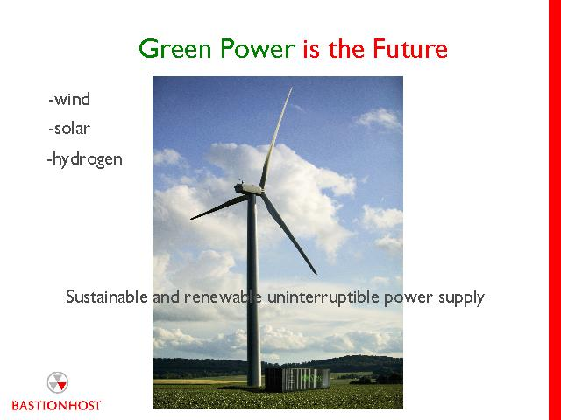
Grid in a Box at windmill
Source: www.Bastionhost.com

Slide 13
Next Generation Internet to reduce Global Warming
PROMPT: New $50m research consortium made up of Bell Canada, Nortel, Ericsson, McGill, UoT etc
Any future internet network, project, program or application must have as its primary objective of a zero carbon footprint
Zero carbon condition applies to
  all optical, wireless and last mile networks
  all routers, switches, and web servers
  all applications, computers
  and all customer devices such as PCs, mobile phones, PDAs etc

Slide 14
Problem: No business case for FTTh
Broadband networks, whether wireless or FTTx, overbuilders, municipal, requires huge capital outlay. In addition:
  Low takeup – “Tyranny of the takeup”
  Revenues declining as more and more applications are free
  Over the top providers are capturing most of the value
Many companies starting to offer free broadband, both wired and wireless
  Inuk, Sky, TalkTalk, Google, Microsoft, Cable and Wireless etc
  Cable TV services are moving to the Internet
Business case for closed networks like Verizon FiOS are uncertain

Slide 15
Carbon Reward Strategy for last mile infrastructure
Provide free high speed Internet and fiber to the home with resale of electrical and gas power
Customer pays a premium on their gas and electric bill
Customers encouraged to save money through reduced energy consumption and reduced carbon output
Customer NOT penalized if they reduce energy consumption
  May end up paying substantially less then they do now for gas + electricity + broadband + telephone + cable
Network operator gets guaranteed revenue based on energy consumption rather than fickle triple play

Slide 16
Thank you
More information
http://green-broadband.blogspot.com

